Slide 1
MA’s topic proposal (Draft)
Juan Carlos Reyes Andrade, ICS 2021.01.27

Slide 2
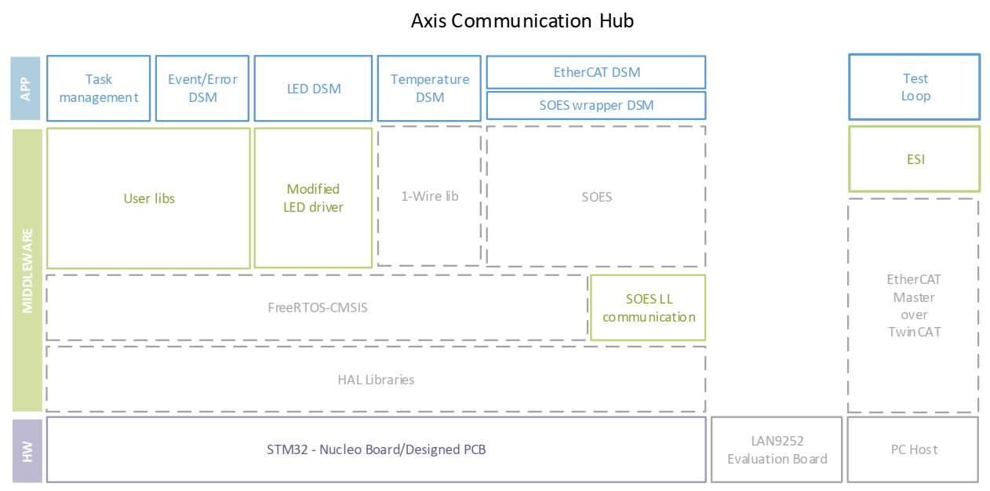
Axis communication hub
Current structure, highlighting network related tasks, event handler and peripheral control-related tasks.
Tasks as FSMs

Slide 3
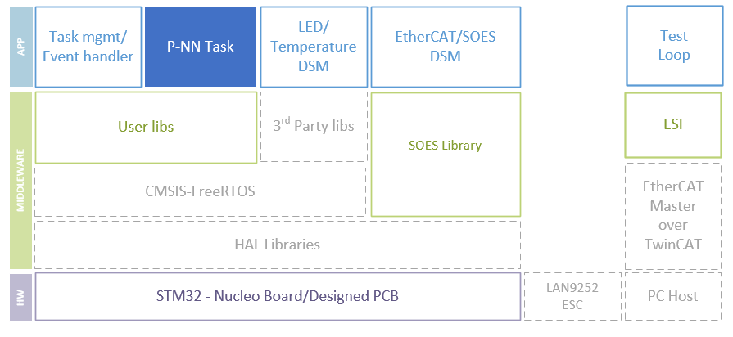
Structure with new feature
Proposed structure with highlighted Neuronal Network running as a task. Other tasks merged only for space reasons.
Highlighted block can be adapted to any functionality.

Slide 4
Implementation of a DNN
CMSIS-NN and Glow (Neural Network compiler)
Implementation references in 600 MHz Cortex M7 from NXP i.mxRT, moving from a RAM and Flash Usage of 1.2 Mb to less than 200 KB
Rough steps:
Tensor Flow (or Pytorch) >> ONNX >> Glow >> Glow Bundle >> an M4/M7 target
Challenge: Optimize a Neural Network for M4 with a 180 MHz + FPU and 128 KB RAM.

Slide 5
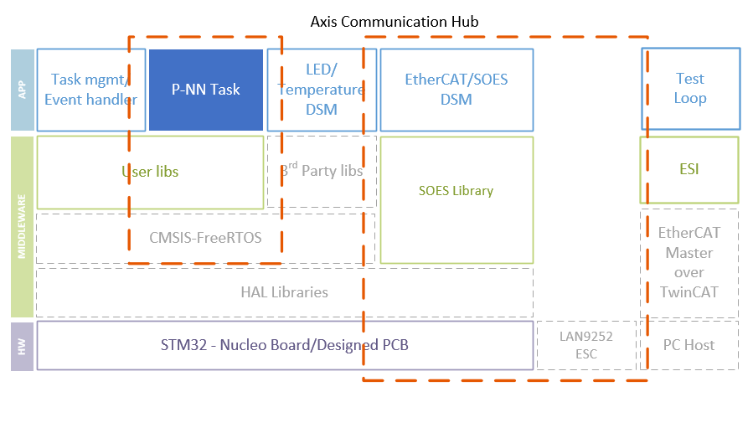
V&V techniques
Verification, validation and testing techniques could be really demanding according to the formality level.
The firmware implementation can be analyzed in parts.
Proposed the Network-related tasks and the NN-related tasks.

Slide 6
Leading questions
How functional is the performance of the NN than can be achieved in such setup?
Are the reachability analysis’ results through NNV translatable to FFNN running on ARM-architectures?
Does the sensor readout functionality of the ACB fulfill the a-priori requirements for NNCS of the NNV tool? Such that the NNV works properly on current application?
Goal: Use efficiently the microcontroller families to compare them with specialized or high-performance processors such as M7 or M55 or FPGAs.

Slide 7
Proposals
Rely on 3 topics
Software for embedded systems, software verification and machine learning.
Optimization of a DNN to be ported on a M4 or M7 ARM architecture.
Exploring the capabilities of a M4 or M7 Processor in comparison with those of high-in-resources NXP Chip or others.
Formal verification of NNs (only the NN task)
Verification of FSMs in embedded systems (Network tasks + P-NN as “black box”)
Notes:
About the implementation:
NXP M7 Processors
This will show the practical constraints for voice recognition of a Neural Network that has been trained with a given software.

Slide 8
Neural Network Verification Tool: Notes
NNV: The Neural Network Verification Tool for Deep Neural Networks and Learning-Enabled Cyber-Physical Systems [3]
Motivated by the usage of DNNs on safety-critical cyber-physical systems (CPS)
Supports both sound and complete reachability algorithms for verifying safety and robustness properties of FFNN. (Perceptrons and deep convolution NN are FFN)
Uses set representations such as polyhedral, zonotopes and abstract domain representations. (to be reviewed)
Works on Matlab tool, taking translated NN models exported by Keras and Tensor using ONNX format and HyST transformation tool.
(Still analyzing)

Slide 9
DL Compilers The Deep Learning Compiler: A Comprehensive Survey, 2020 [4]
ONNX model file
JIT compilation using, lists as in [4] :
TVM (tvm.relay.frontend.from_onnx interface)
nGraph (ngraph-onnx Python pckg)
Glow (ONNXModelLoader)
XLA (tensorflow-onnx Python pckg)
TC does not support ONNX files
Target hardware: CPU+GPU no ARM
TVM and Glow support apparently the ARM architecture
Frameworks:
TVM: Tensorflow,tflite,keras,pytorch,caffe2,mxnet,coreml,darknet
nGraph:paddlepadde
STM32Cube.AI?
Notes:
TODO:
Check the compatibility of frameworks.
Are the kernel libraries in the optimization (IR) the ones that should work with CMSIS-NN???
What is the key difference between the training of a NN using JIT or AOT? Is the latter the one tha is going to be downloaded to the MCU??
NOTES about the way of translating the NN
Creation of the computation graph
Vocabulary:
Backend refers to the last translation of a DNN, the one that is specific to the hardware.
Frontend refers to whatever is in the graph model

Slide 10
FANNCortexM: Notes
FANNCortexM: An Open Source Toolkit for Deployment of Multi-layer Neural Networks o ARM Cortex-M Family Microcontrollers , 2019[1]
FANN is a free open source neural network library that implements multi-layer ANNs in C. These can be ported and optimized in ARM Cortex-M architectures.
FANNCortexM highlights the importance of CMSIS (a vendor independent HAL for Cortex-M processors) by using optimized product functions that allows efficiency increments in execution time by ~30%.
Tested with a 6-input, 3-class perceptron with 2 hidden layers and evaluation of a network with 1000 nodes and 47900 weights (256kB).
Process flow: create/obtain dataset, preprocessing, define/train NN, deploy on device.
(Still analyzing)

Slide 11
Approximated time schedule
Option 1
Hardware/NN compilers research – MicArray/Framework Intro – RoP – PCB design – Optimization* – Report
First review of performance: 3rd Month
Physical implementation: 5-6th Month
Option 2
PCB design – MicArray/Framework Intro – Hardware/NN compilers research – RoP – Optimization* – Report
Physical board: 3rd Month
First review of performance: 5-6th Month
Possible official kick-off meeting: 1st April
This includes only the NN-related tasks.

Slide 12
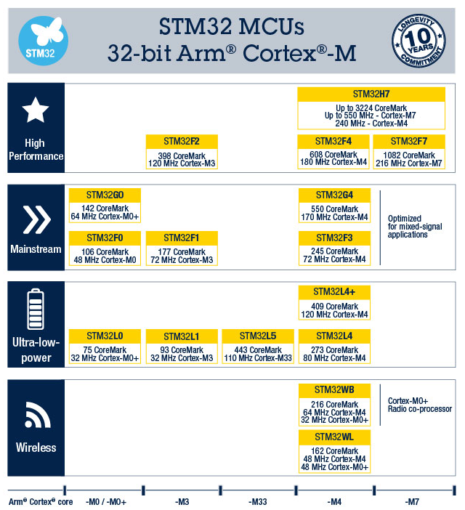
ST Portfolio

Slide 13
References
[1] M. Magno, L. Cavigelli, P. Mayer, F. v. Hagen and L. Benini, "FANNCortexM: An Open Source Toolkit for Deployment of Multi-layer Neural Networks on ARM Cortex-M Family Microcontrollers : Performance Analysis with Stress Detection," 2019 IEEE 5th World Forum on Internet of Things (WF-IoT), Limerick, Ireland, 2019, pp. 793-798, doi: 10.1109/WF-IoT.2019.8767290.
[2] J. C. Reyes, “Development of an embedded communication hub for sensor data acquisition in a robotic system”, September 2020, Research Project supervised by the Research Group smartPORT of the Technical University of Hamburg (TUHH)
[3] Tran, Dung & Yang, Xiaodong & Manzanas Lopez, Diego & Musau, Patrick & Nguyen, Luan & Xiang, Weiming & Bak, Stanley & Johnson, Taylor. (2020). NNV: The Neural Network Verification Tool for Deep Neural Networks and Learning-Enabled Cyber-Physical Systems. 10.1007/978-3-030-53288-8_1.
[4] Li, Mingzhen & Liu, Yi & Liu, Xiaoyan & Sun, Qingxiao & You, Xin & Yang, Hailong & Luan, Zhongzhi & Qian, Depei. (2020). The Deep Learning Compiler: A Comprehensive Survey.

Slide 14
Thank you!

Slide 15
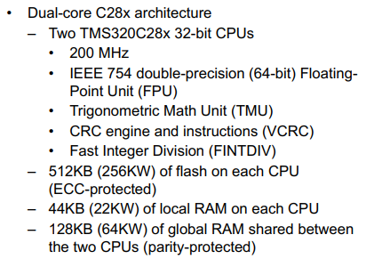
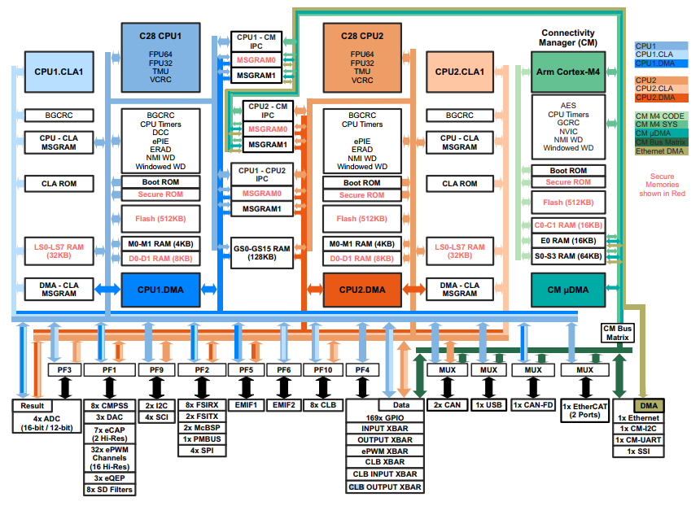

TMS320F28388D

Slide 16
Proposal: details
Implementation of an NN using FANNCortexM on an Axis Communication Hub to evaluate its performance and usage reliability within an EtherCAT Network.
Use a pre-trained NN with multi-layer perceptrons instead of deep convolutional networks for an application based on a sensor that does not produce images.
According to [1], it will be focused on define/train NN, deploy on device stages, using a given data set at an specific accuracy.
Current Axis Communication Hub integrates a STM32F446RTE MCU with ARM Cortex-M4 architecture, has FPU and it is within the high performance family ST processors. 512kB Flash/128+4KB RAM[2].
Notes:
FANN conversion, hyperparametrization, identification of best network, FPU configuration, implementation to HW, measure performance and power.

Slide 17
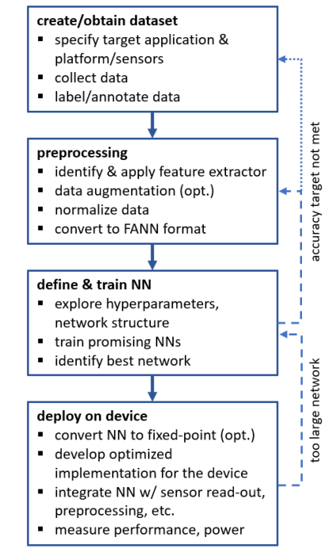
Process flow according to [1]

Slide 18
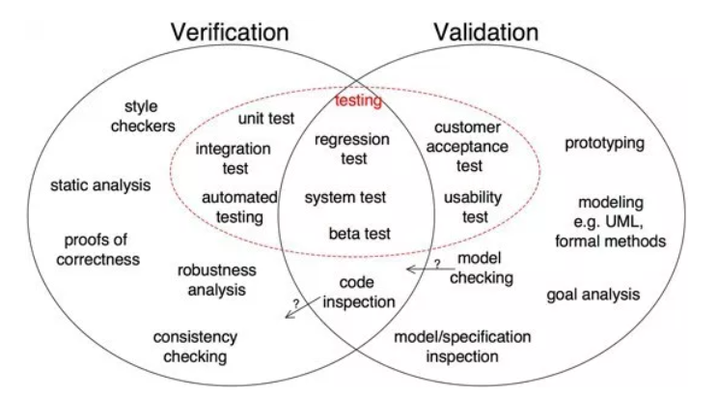
V&V
Validation is concerned with checking that the system will meet the customer’s actual needs, while verification is concerned with whether the system is well-engineered, error-free, and so on.
Set of tools according to the nature of what is going to be validated or verify and the level of formality.

Slide 19
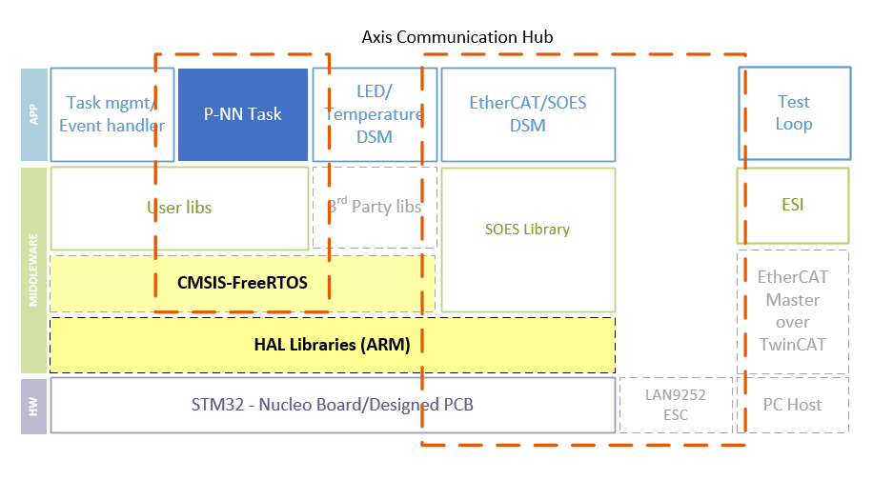
Flexibility

Slide 20
Further steps:
Go through documentation:
FANNCortexM: An Open Source Toolkit for Deployment of Multi-layer Neural Networks on ARM Cortex-M Family Microcontrollers : Performance Analysis with Stress Detection
CMSIS-NN: Efficient Neural Network Kernels for Arm Cortex-M CPUs
NNV: The Neural Network Verification Tool for Deep Neural Networks and Learning-Enabled Cyber-Physical Systems
Detail the level of formality with someone experienced in NN or machine learning.

Slide 21
Institute of embedded systems at TUHH
Test Optimization for Embedded Systems
Technology-Level Test Vector Generation
Verifying Artificial Neural Networks
Assessing the Performance of Embedded Machine Learning

Slide 22
Institute of embedded systems at TUHH
Test Optimization for Embedded Systems
Embedded systems are not directly visible to the end user. However, they must be extremely reliable to guarantee correct behavior of larger technical systems. For this reason elaborated test procedures are applied that successively validate each embedded system before shipping. Individual hardware components, electrical interfaces and, finally, the functionality of the complete embedded system including software are incrementally tested. The goal of this work is to work on testing data from a actually running testing process at an industrial partner's facilities in Hamburg.
Technology-Level Test Vector Generation
Test vectors for integrated circuits applied to each produced chip guarantee proper functionality and highest quality standards. More recent improvement in circuit technology and the use of advance approximate processing units makes a precise differentiation of good and bad chips on the logic level more and more difficult. The topic proposed here will consider low-level technology information for generating tests for advanced production processes and approximate hardware.
Verifying Artificial Neural Networks
Formally verifying the correctness of procedures and systems used in safety related areas is a must. Artificial neural networks have been proven very effective in solving many tasks in every day life. However, methods deciding whether an artificial neural network never violates safety guarantees are only at their infancy. The goal of this work is to study the state-of-the-art in verifying correctness of artificial neural networks.
Assessing the Performance of Embedded Machine Learning
Most suppliers of advanced embedded processing devices provide software libraries and hardware support to improve the performance of machine learning in embedded systems either for training classifiers, for applying learned classifiers or both. But how efficient are these embedded platforms. The goal is to use and evaluate the performance of embedded machine learning platforms.

Slide 23
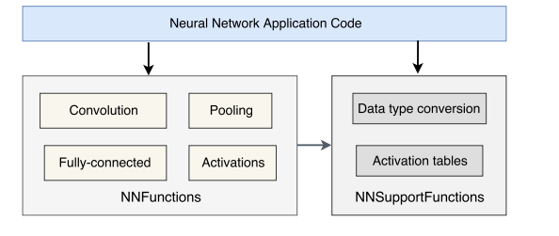
Notes from Papers
Neural Network Kernel functions structure

Slide 24
Questions to the proposal
Review the possibility of using the NNV tool for models exported/transformed by the CMSIS-NN or FANN-CortexM frameworks.
Are the reachability analysis’ results through NNV translatable to FFNN running on ARM-architectures.
Does the sensor readout functionality of the ACB fulfill the a-priori requirements for NNCS of the NNV tool? Such that the NNV works properly on current application?
Two possible applications: Force-torque sensor or speech recognition.

Slide 25
Further Reading:
Glow apparently for “rich on resources” hardware. [4]
TVM and Gravity show up with code optimization, where the latter has smaller footprint.
Tensor Flow Lite is also in the way.
2021 01 Gravity An ANN Compiler for Embedded Applications
2020 02 The Deep Learning Compiler A Comprehensive Survey
2020 10 TensorFlow Lite Micro Embedded Machine Learning on TinyML Systems

Slide 26
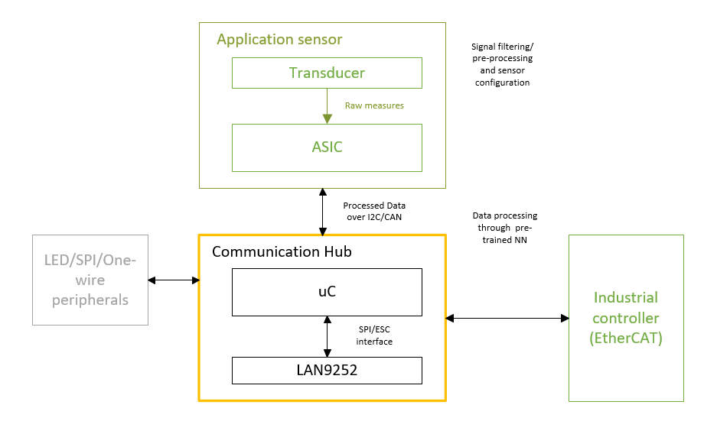
Data flow structure
Proposal assumes a given and high reliability of the sensor and industrial controller.
Whereas the communication hub’s reliability depends on the right execution of its internal features to not affect the “reliability chain”.

